Slide 1
Conference Skills Workshop: Practical Matters
Dr Jim Briggs

Slide 2
Contents
Getting permission to go
Booking
Travelling
Presenting
Networking

Slide 3
Getting permission to go
Policy varies from department to department
Generally, you need:
permission from your supervisor
that the conference is appropriate
that your contribution is appropriate
permission from your head of department
for you to spend University money
for you to travel abroad (if the conference is outside UK)

Slide 4
Paperwork: expenditure
Approval of expenditure
Form F30 (F1 for staff)
Available from your department/faculty's finance officer
Research your costs
Complete the form: estimate expenditure
Pass it on for authorisation
Do it as soon as possible to take advantage of cheap flights, early-bird discount, etc.
Allow time to get visa (if applicable)

Slide 5
Before you fill in the F30, you need to research your costs
Expenses people usually remember
Main travel costs (e.g. flight / train tickets)
Conference registration fees
Accommodation costs (unless included in conference fee)
Expenses people often forget
Cost of getting from Portsmouth to airport (e.g. train, bus)
Cost of getting from destination airport to conference venue (e.g. train, bus, taxi)
Cost of travel between hotel and conference venue
Cost of your meals each day you are away
Currency conversion costs
Cost of applying for a visa (if applicable)
including travel (e.g. to London) if need to apply in person
Producing your poster (if applicable)
Any other likely expenses

Slide 6
Calculating your expenses
Go for cheapest reasonable but nobody expects you to walk there or sleep on the floor!
The conference social event(s) is usually regarded as a reasonable expense: you need to network
You need to stick to your budget
Round your figures up in case things work out a bit dearer than expected

Slide 7
Sources for research
Your favourite travel agent web site:
www.travelsupermarket.com/
www.lastminute.com/
www.google.co.uk/flights/
www.skyscanner.net/
Note: 'Budget airlines' can be a false economy – extras (luggage, meals, etc.) add to the cost
Local guides to your destination
The conference website
Will often recommend local hotels and transport

Slide 8
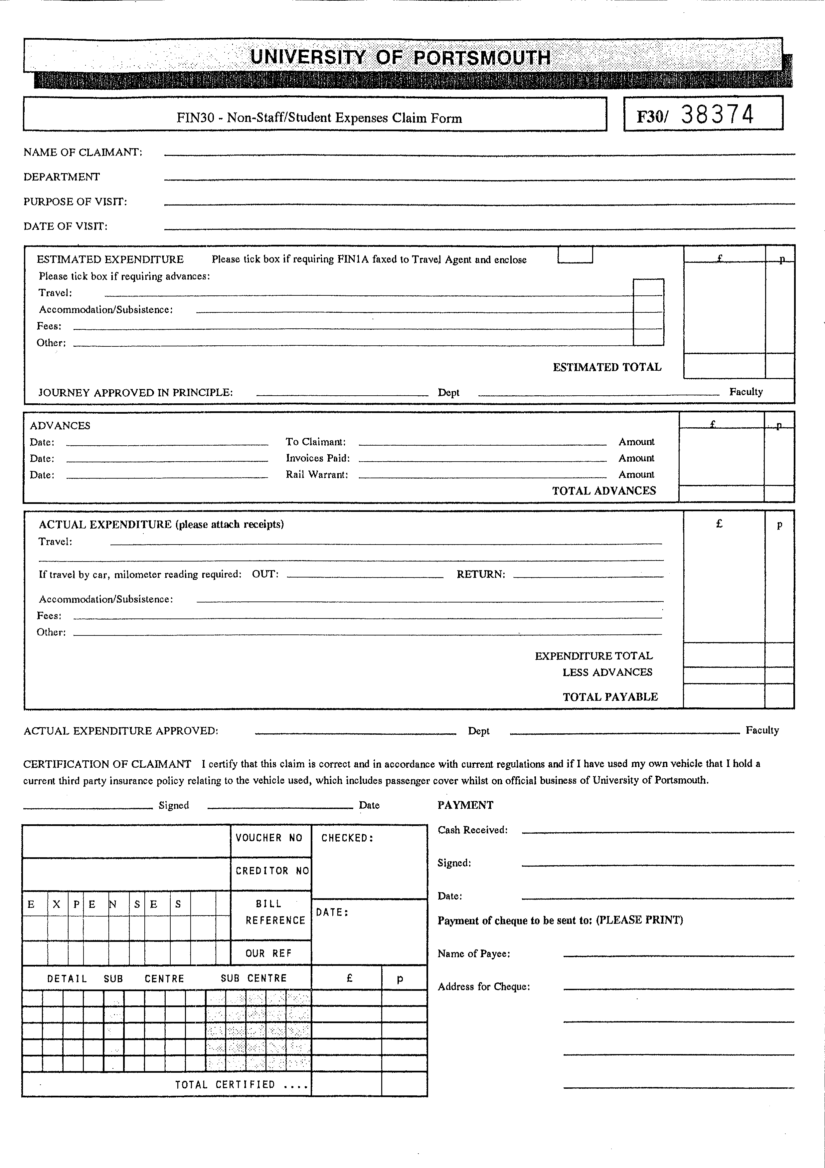
Filling in an F30
Name, department – should be easy!
Purpose of visit: "Attend/Present at X conference in Y place" – remember to identify your destination
Date of visit – remember to include your travel dates, not just the dates of the conference
Estimated expenditure – remember to include everything!
Tick the boxes if payments are to be made in advance
Note the number in red at the top-right (38374 here)

Slide 9
Paperwork: travel overseas
Travel overseas
Online form:
http://www.port.ac.uk/special/overseastravel/
Fill it in, including your F30 number
You will be covered by the University's travel insurance policy
Download card with emergency phone numbers on it
Read Occupational Health advice
Vaccinations
First aid kits
Complete a risk assessment
Check travel advisories
International Office may advise you if any risks are reported

Slide 10
Travel advice
See http://www.port.ac.uk/special/overseastravel/travelplanningtips/
Check for public holidays, elections, big sporting events, etc. that may make travel more difficult than usual
If you are travelling to a country you have not been to before, do some research
Check the medical provision in-country before you go
If you wear glasses or contact lenses, pack an extra pair
If you take medication, take a copy of your prescription with you and the generic names for the drugs
Charge your mobile phone daily
You don't want the battery to run out in an emergency or when you are on a long journey in-country

Slide 11
Booking
Only once F30 is approved can you book
Normally use the University-approved travel agent
Some faculties have a credit card for online booking
Some conferences will invoice the University
Talk to your finance officer about the above
You will want the University to pay for as much as possible in advance to avoid large expenses on your own credit card or bank account
Do it as soon as possible to take advantage of cheap flights, early-bird discount, etc.
Don't forget to apply for your visa (if applicable)
If you look like exceeding the budget, talk to the budget holder

Slide 12
Planning what to do
Prepare your presentation well in advance
Rehearse it
Time it
Get feedback
Think about who the audience will be
Pitch it at the right level
Think about who else is likely to be at the conference who you would like to meet

Slide 13
Keeping in touch
Will your mobile phone work overseas?
if not, it may be possible to borrow a university one
Will you be able to get Internet access (e.g. Wi-Fi) at the hotel or conference?
Will you be able to check email while you are away?

Slide 14
Packing for business
Normal things you would pack
Clothes: what is the weather going to be like? what are you going to wear to speak? what are you going to wear at the conference dinner?
Toiletries and medication
Phrasebook
Mobile phone (and charger)
Things you might not take on holiday
Laptop (remember the power supply, adapter, cables)
Note-taking equipment (paper, pens, etc.)
Business cards (borrow from your supervisor if you don't have your own or use compliments slips)

Slide 15
Packing your PowerPoint
Do at least 3 of the following:
email it to the organisers in advance
take your own laptop
take a copy on a memory stick
email a copy to yourself
upload a copy to the cloud or file sharing service
take a paper copy
Use the University template (like this)
http://www.port.ac.uk/departments/services/marketingandcommunications/corporateidentity/

Slide 16
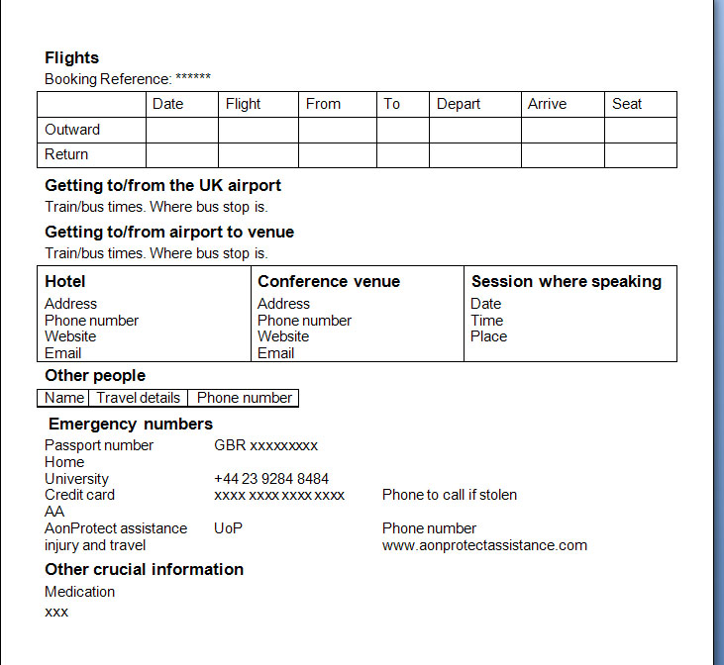
Before you go
Leave travel and contact details with your supervisor and/or departmental admin
Take details of your trip with you (multiple copies)
Email yourself a copy of this and your passport
Print out key information about airports, trains, hotel, conference venue, host city, health problems, etc.
Program key contact numbers into your phone
Have a map showing your hotel and the conference venue
What's your backup plan if you miss a flight or train?

Slide 17
Travelling there
Make sure you've got:
your passport
your tickets
your presentation
your credit card
Get to the airport early
3 Rs:
Read about your destination
Rehearse your presentation
Relax

Slide 18
Once there
Tell someone back home you've arrived safely
but don't tell the world (e.g. Facebook, Twitter) your home is open for burglars!
Check the route and transport between hotel and venue
Check local weather
Where do you go to register, pick up your name badge, etc.
Is there a welcome reception?
Check you've still got your presentation with you

Slide 19
Active participation
Check the conference schedule
Especially when you are to speak
Plan which of parallel sessions you will go to
Pay attention during the talks
Make notes
Talk to people during the breaks
Tell them about your work, your university
Discuss the other presentations
Make friends, contacts (some for life)

Slide 20
Presentations are easy
Speaking in public is an exercise in selling
Enjoy being nervous
Be prepared
Grab the audience's attention
Work the audience (keep them awake)
Don't just read your PowerPoint
Look good
Make eye contact and don't turn your back
Keep to time
Don't apologise for not being an expert
Smile
Try to make a speech like a conversation
Try a little humour (but not too much and take care of your audience)
Show enthusiasm for your work
Show your email address and/or website on your final slide
Take questions at the end
It's OK to say "don't know"
Follow up detailed questions after your session

Slide 21
Travelling home
Don't miss your plane!
Leave the conference early if necessary
Review your notes
Write up your trip report
Relax!

Slide 22
Once you get home
Tell everyone you're home safely
Report to supervisor, colleagues
Some departments ask you to give a seminar
Follow up contacts or people you missed meeting
Start planning your next trip!

Slide 23
Questions?
Dr Jim Briggs Jim.Briggs@port.ac.uk

